Slide 1
DELHI REAL ESTATE PRICE PREDICTATION
BY : KARTIK GOEL
MCA 1ST SHIFT

Slide 2
SUMMARY
In this project I will be deploying a machine learning model which will be able to predict the prices for real estate specifically in Delhi because I wasn’t able to find a project which was targeting mainly Delhi .
It will be deployed on a webpage so that users can interact with it and get to know the prices
The prices will be based on various factors like total area, no. of rooms , bathrooms etc.

Slide 3
INTRODUCTION
Being extremely interested in everything having a relation with the Machine Learning, the independent project was a great occasion to give me the time to learn and confirm my interest for this field. The fact that we can make estimations, predictions and give the ability for machines to learn by themselves is both powerful and limitless in term of application possibilities. We can use Machine Learning in Finance, Medicine, almost everywhere. That’s why I decided to conduct my project around the Machine Learning.

Slide 4
GOALS
I chose to take Real Estate Prediction as approach.
The goal was to predict the price of a given apartment according to the market prices taking into account different “features” that will be developed in the following sections.
The crucial element in machine learning task for which a particular attention should be clearly taken is the data. Indeed the results will be highly influenced by the data based on where did we find them, how are they formatted, are they consistent, is there any outlier and so on. At this step, many questions should be answered in order to guarantee that the learning algorithm will be efficient and accurate.

Slide 5
Many sub steps are taken to get, clean and transform the data. I am going to explain each one of them to show how they have been applied on my project why they are useful for the machine learning part.
The Data has been extracted from MagicBricks (a website, provides common platform to property buyer and seller ) as I wanted to specifically target Delhi .

Slide 6
SOFTWARE SPECIFICATION /HARDWARE REQUIREMENTS
The software that I will be using is jupyter notebook as I will be working majorly in python
Then for the front end I will be using flask to deploy the machine learning model on the webpage ( front end ).
Choice of operating system is windows 10
In terms of hardware requirements a PC with a minimum of 8GB of ram and a quad core CPU ( an intel i5 7500 in my case ) should be sufficient to make it work.

Slide 7
Technology and tools used in this project :
Python
Numpy and Pandas for data cleaning
Matplotlib for data visualization
Sklearn for model building
Jupyter notebook, visual studio code and pycharm as IDE
Python flask for http server (IDE Pycharm)
HTML/CSS/Javascript for UI

Slide 8
STRUCTURE CHART
Gathering data
Data pre-processing
Researching the model that will be best for the type of data
Training and testing the model
Evaluation
Creating a flask server
Creating and connection frontend

Slide 9
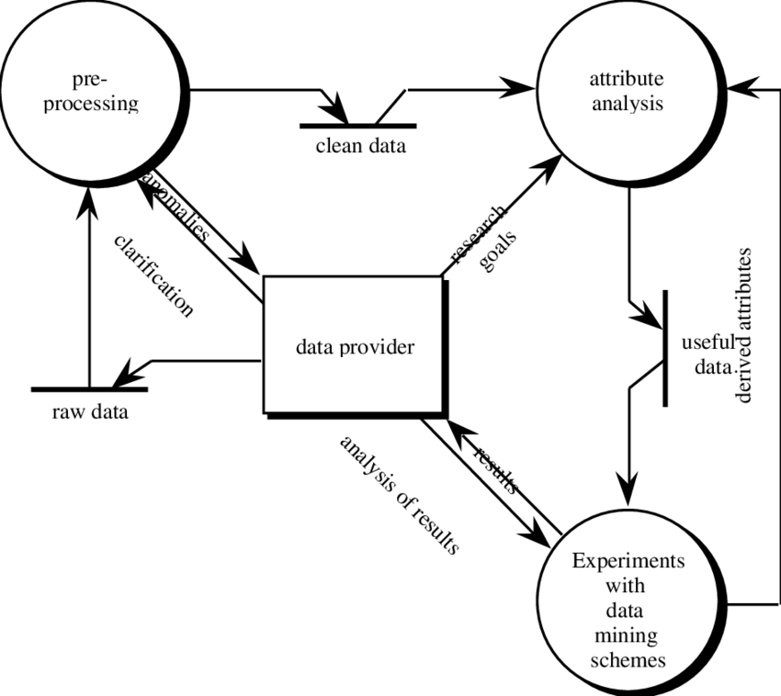
MACHINE LEARNING APPLICATION DATA FLOW DIAGRAM

Slide 10
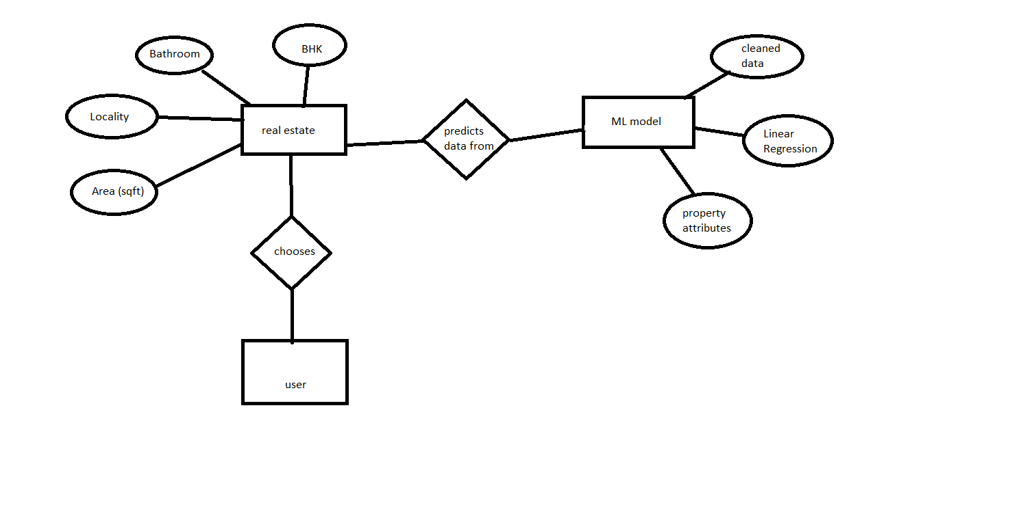
ER DIAGRAM

Slide 11
FUTURE WORK
Currently there is more to add to the project since currently the backend is only designed I have to work on its front end so it could get an interface.
data from different states can be imported to increase versatility.

Slide 12
CONCLUSION
In this data science/Machine learning project we builded a real estate price prediction website. We will first build a model using sklearn and linear regression using Delhi home prices dataset. Then we wrote a python flask server that uses the saved model to serve http requests. And then we build a website built in html, css and javascript that allows user to enter home square ft area, bedrooms etc and it will call python flask server to retrieve the predicted price.

Slide 13
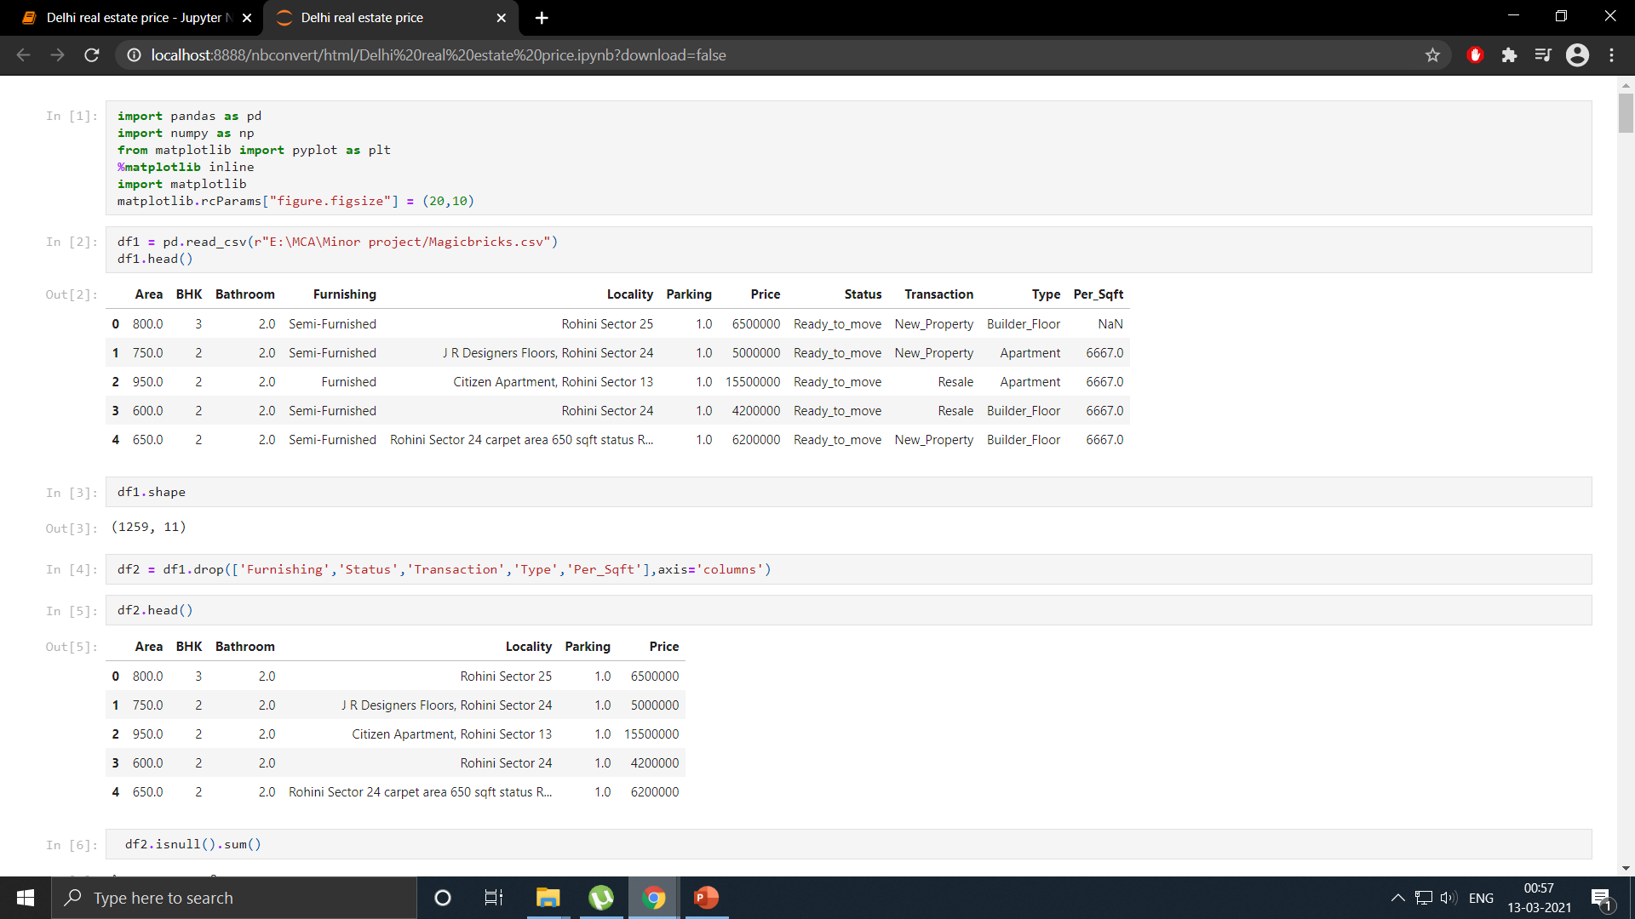
APPENDIX

Slide 14
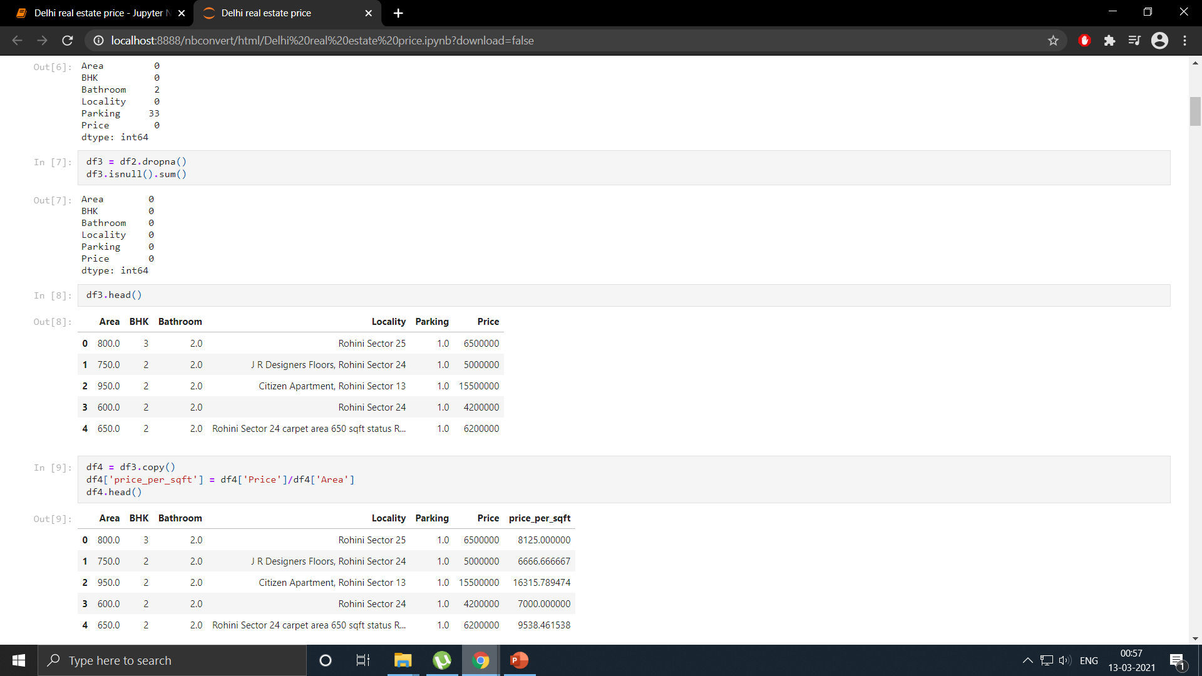

Slide 15
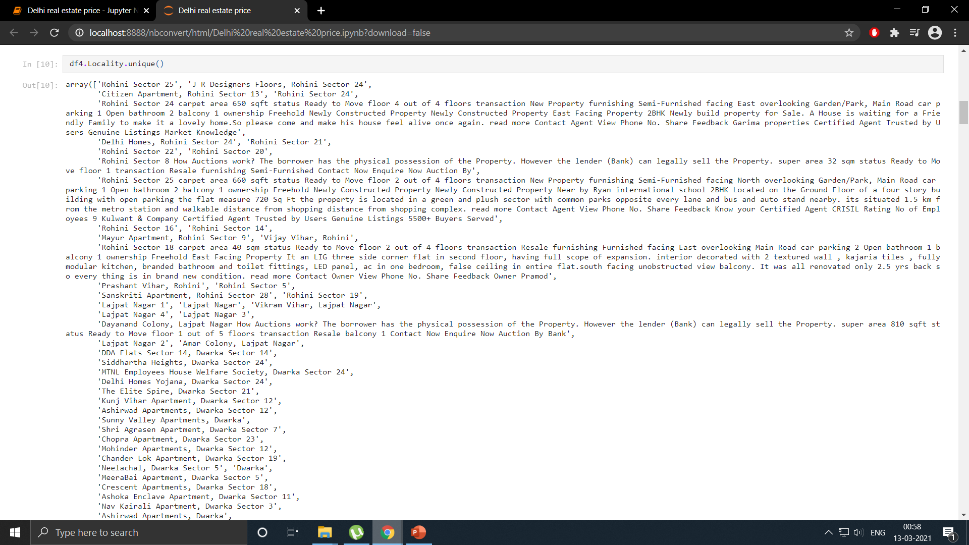

Slide 16
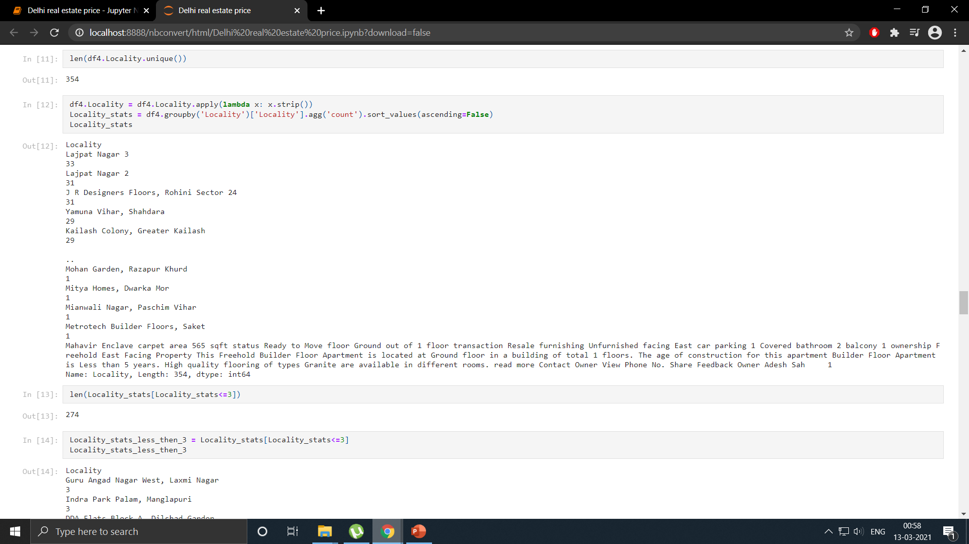

Slide 17
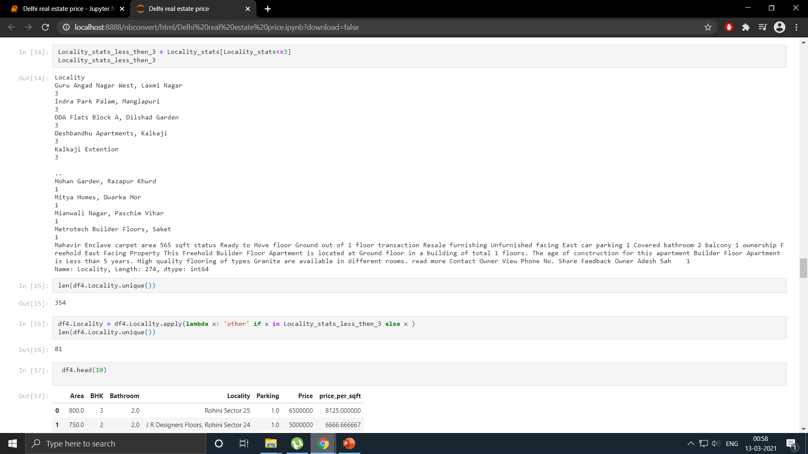

Slide 18
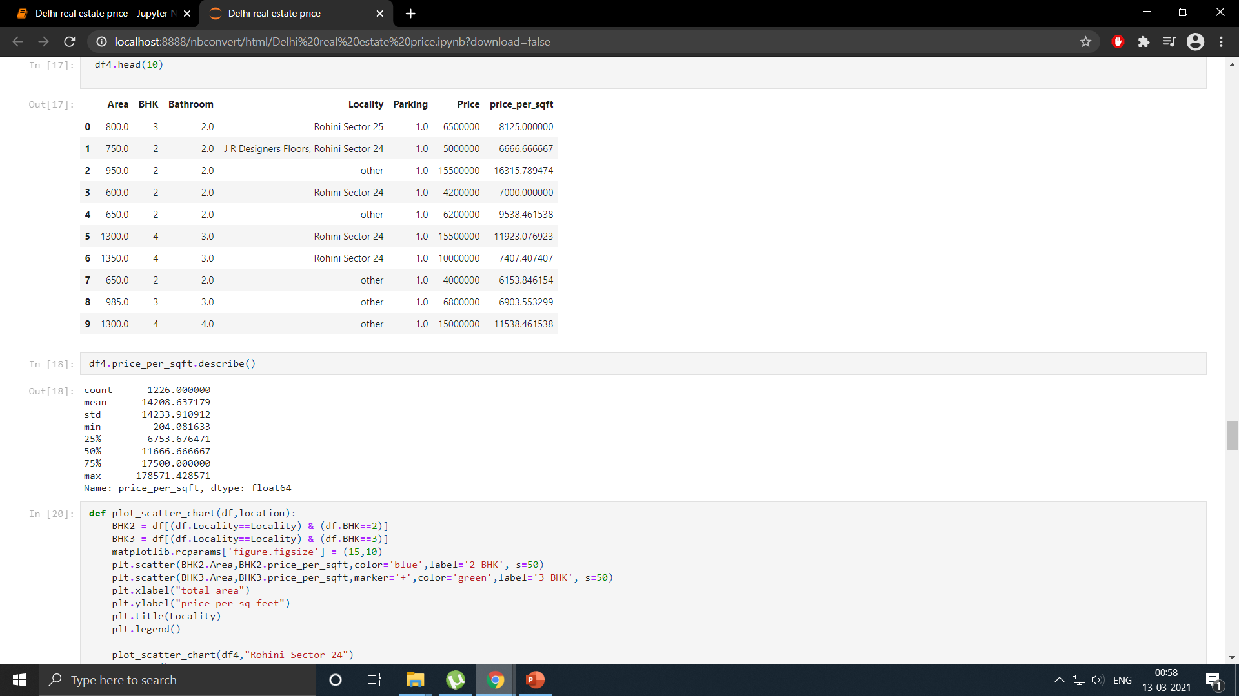

Slide 19
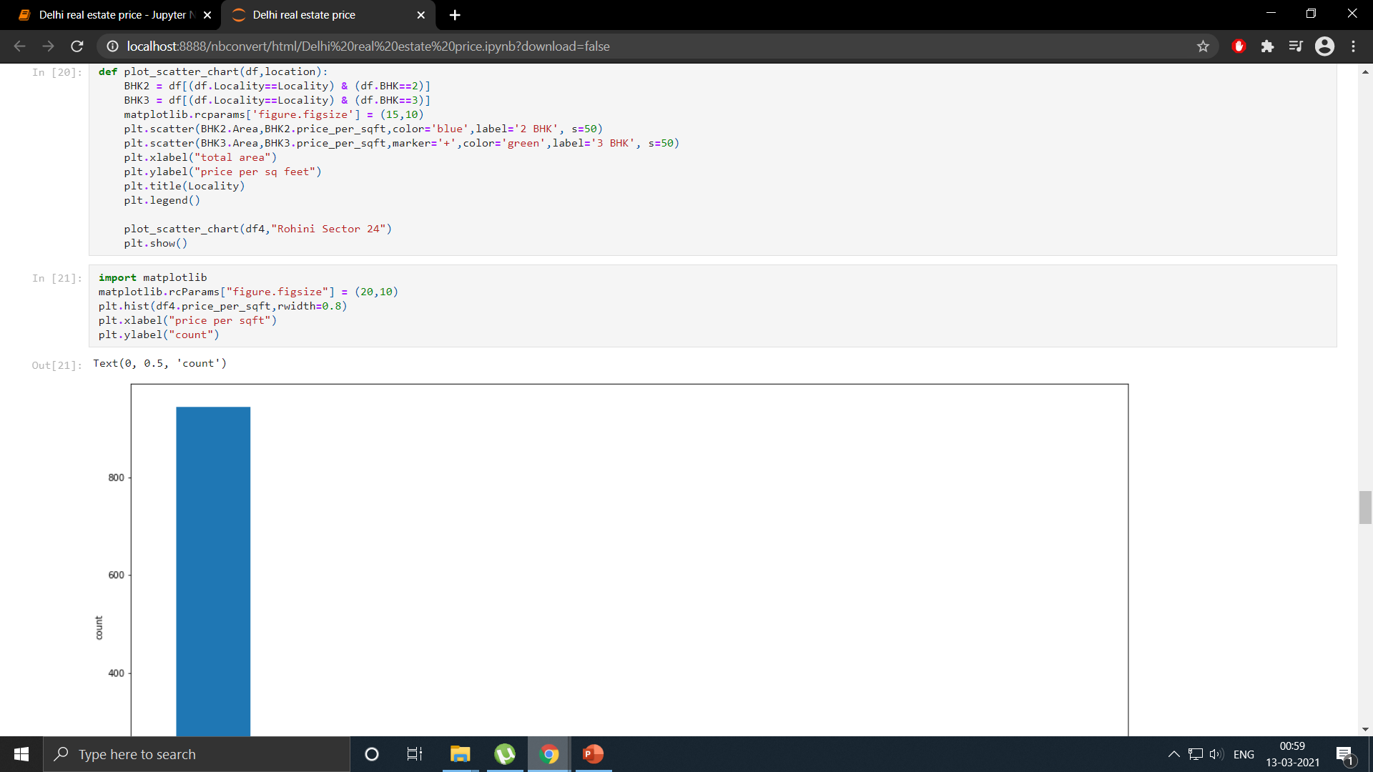

Slide 20
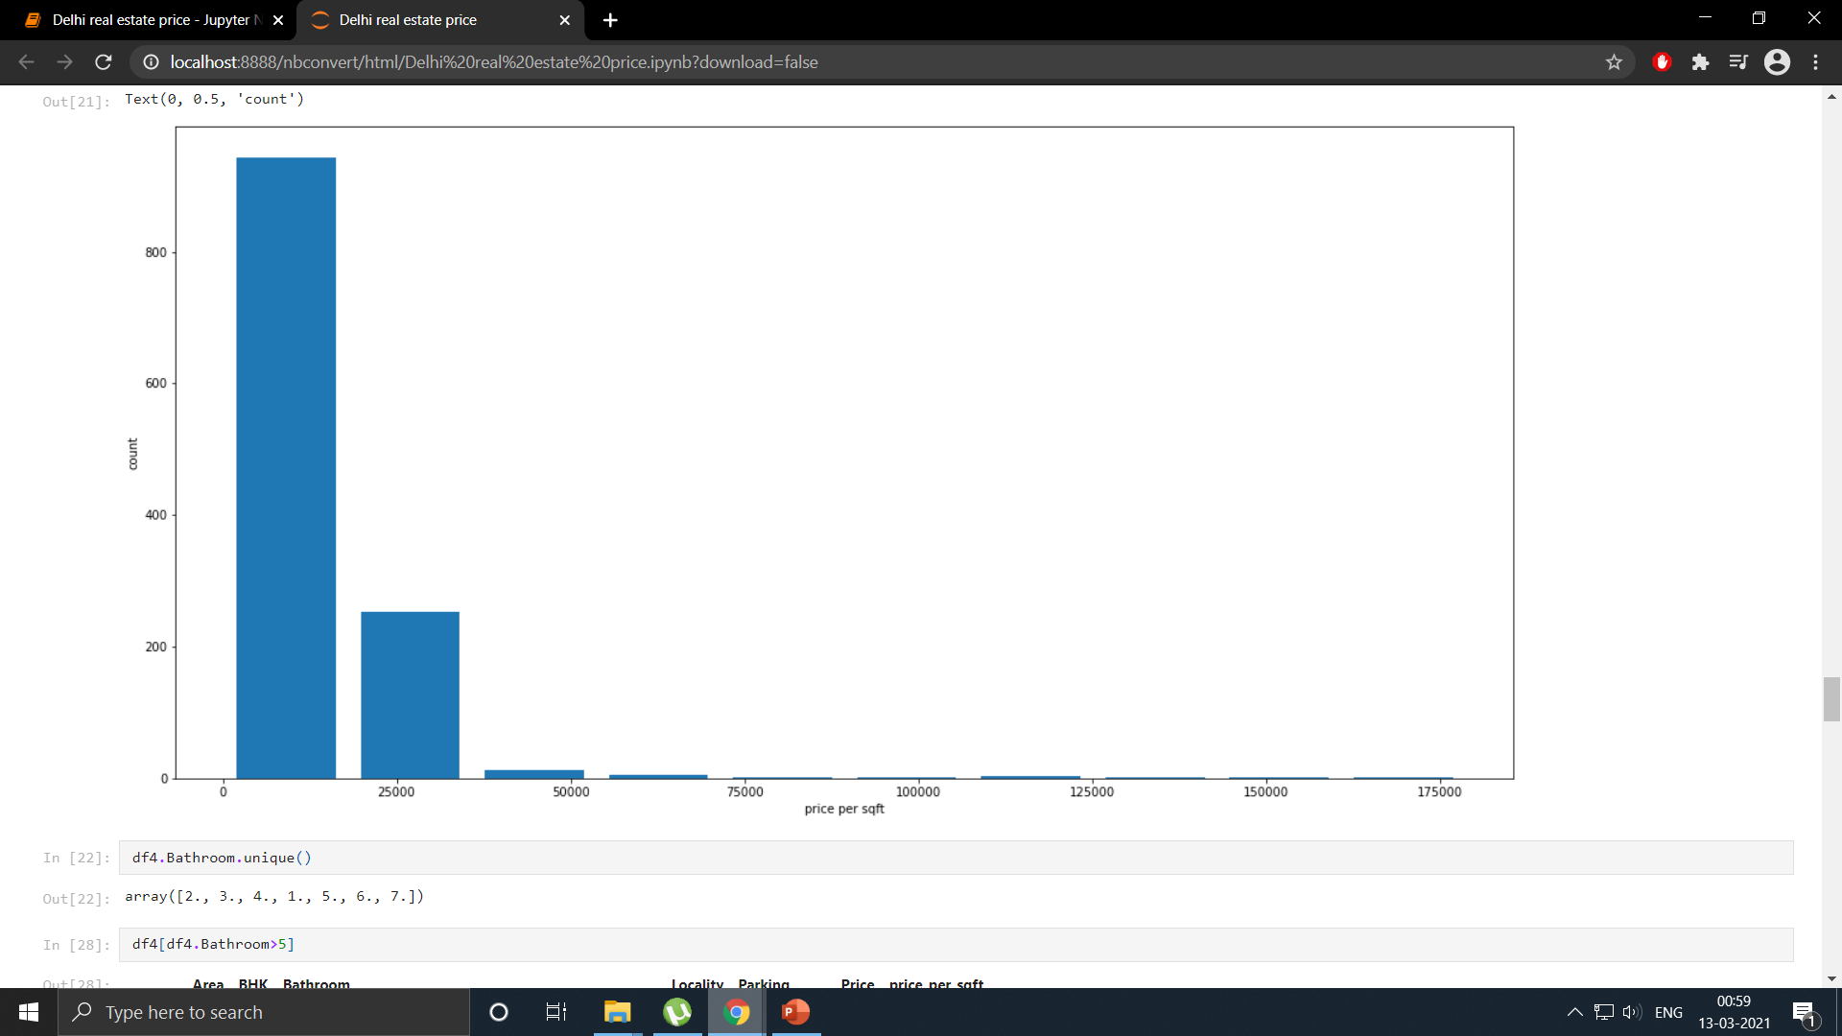

Slide 21
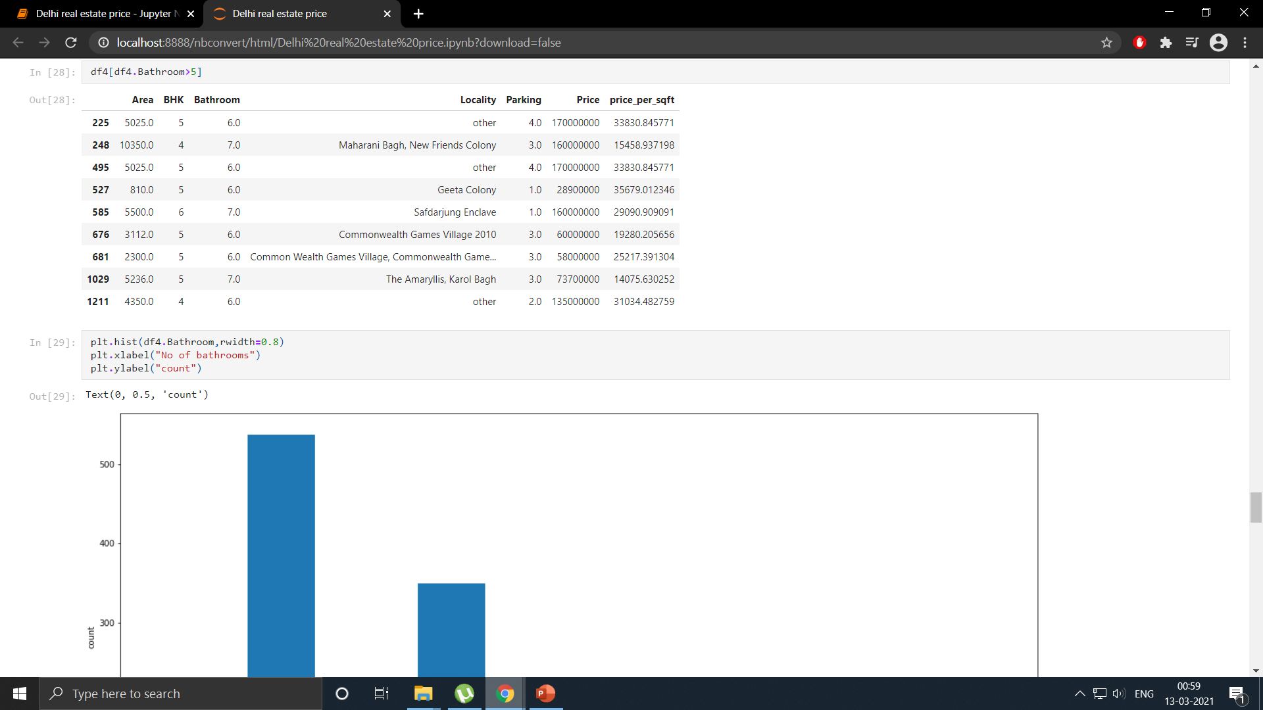

Slide 22
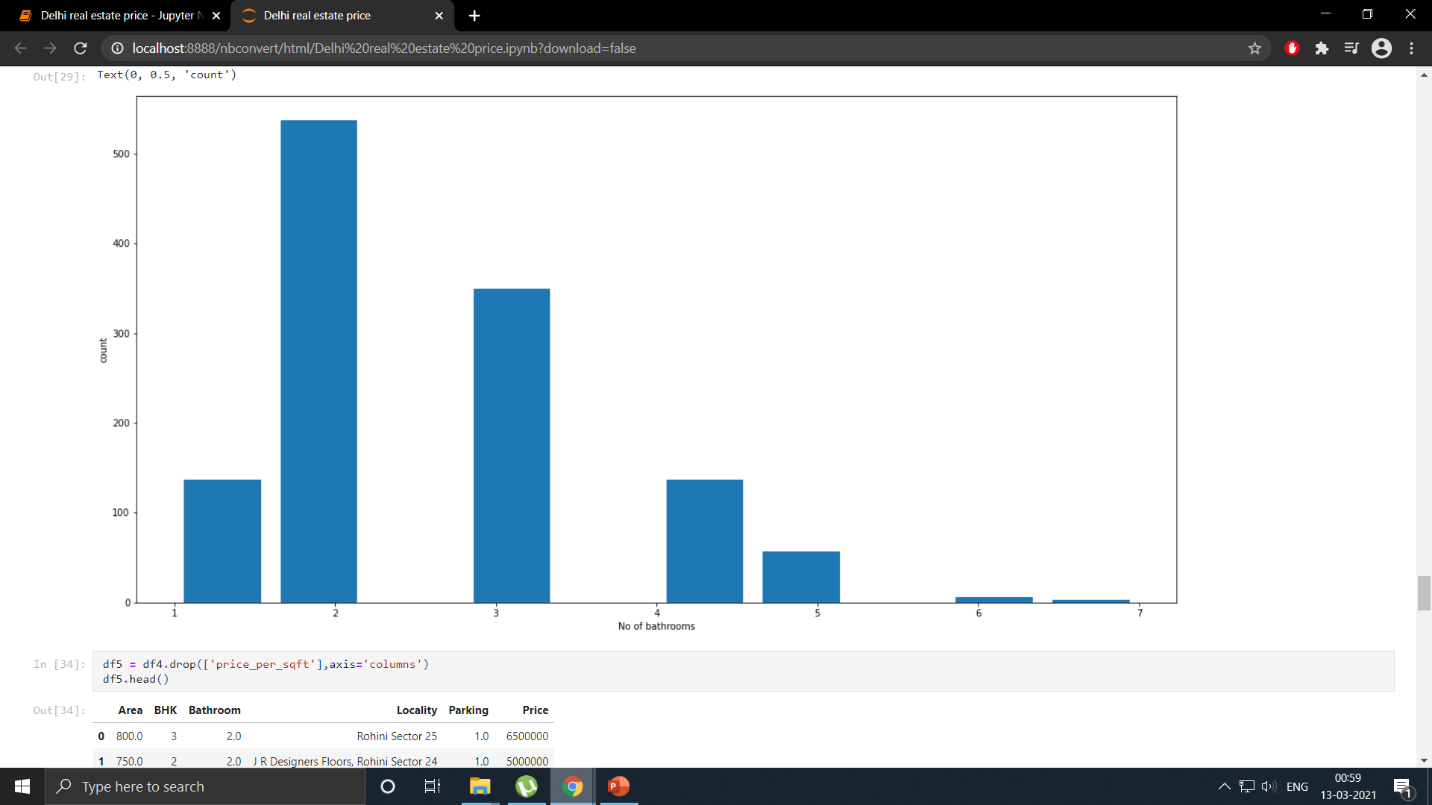

Slide 23
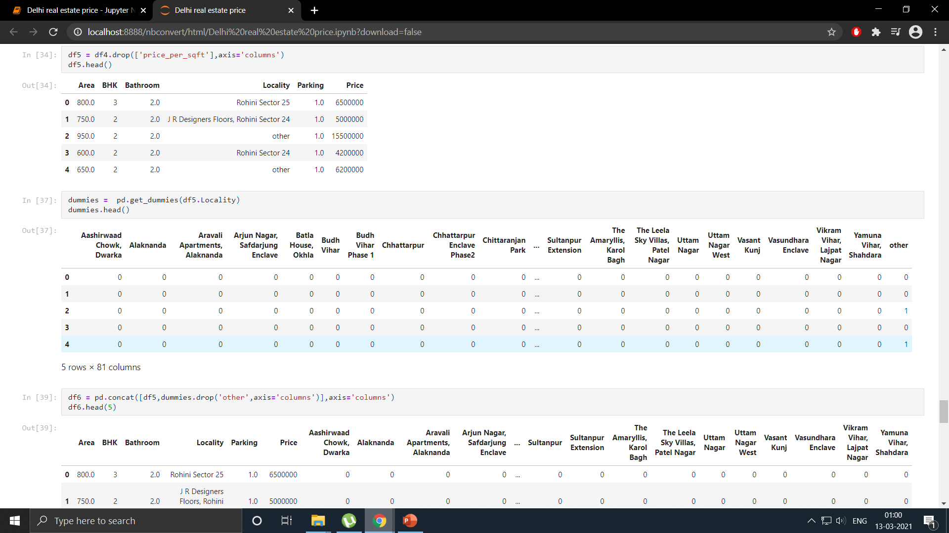

Slide 24
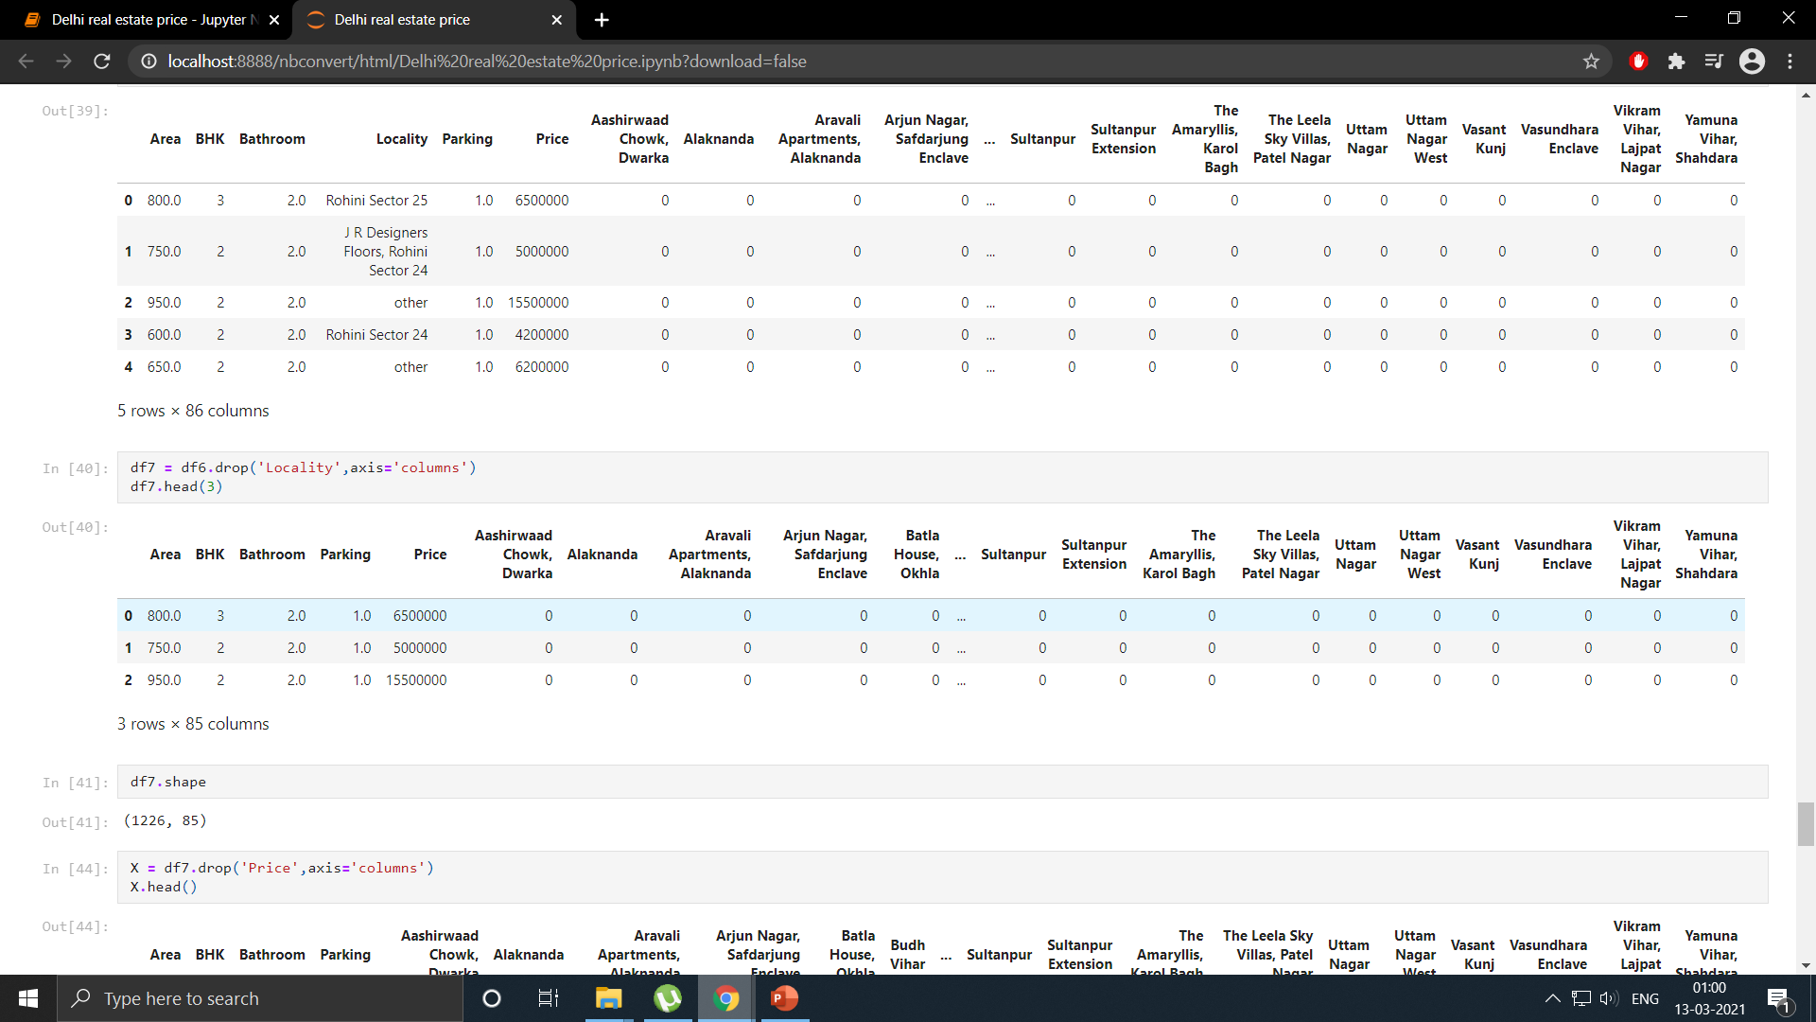

Slide 25
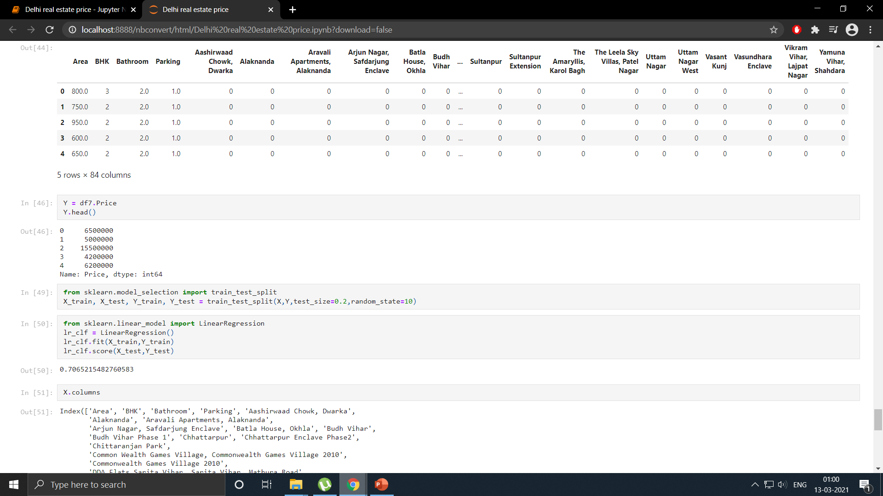

Slide 26
